Slide 1
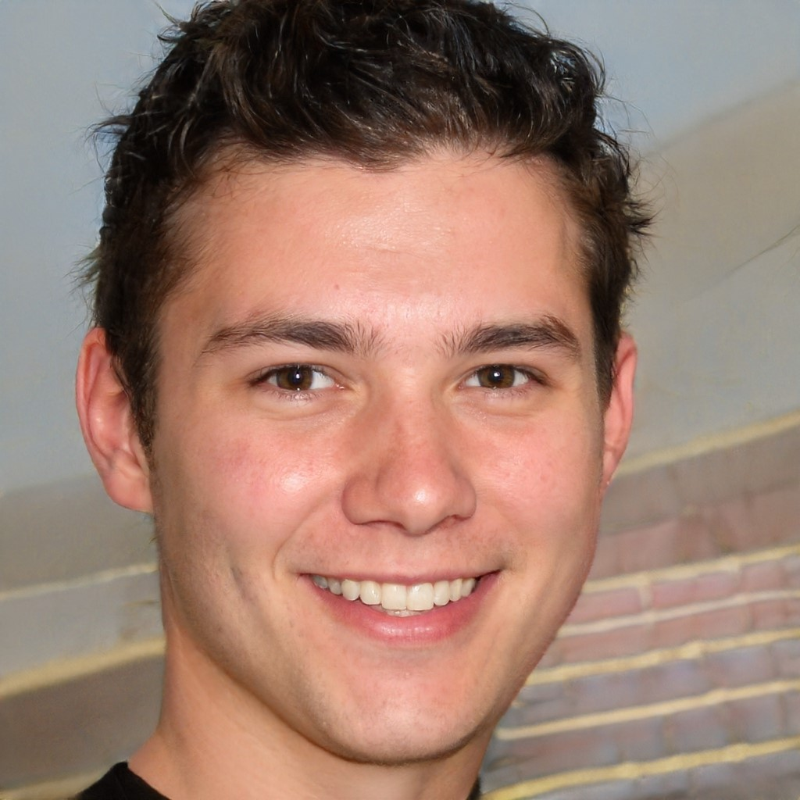



Usuario Estudiante
José Alejandro Agudo
Sobre
Jill is an advertising executive that works for one of the largest advertising agencies in the US. She moved
to San Francisco to take the job and lives in an apartment with two of her sorority sisters. She went to school
for graphic design and hopes to get into selling art some day so moved to San Francisco, but hasn’t found
much time to work on her art. She thinks she might apply for her manager’s job when she goes to work for a
customer next month but isn’t sure yet.
“Estoy obsesionado con
la tecnología y la ciberseguridad”
Edad
29
Goals
Needs
Title
Advertising Buyer
Spend more time
Take the
Do a bit of
Spend more time
Take the
Do a bit of
Location
San Francisco
Education
BA, University of Texas
Stylish
Analytical
Pain Points
Personality
Compassionate
Energetic
Constantly re-learning tools like Google Analytics as they change the features
Spend hours every day manually pasting information between tools
Cannot bring in others to help/collaborate on live documents
Introvert
Extrovert
Favorite Tools
Analytical
Creative
Busy
Open Schedule
Chaotic
Organized
Independent
Team Oriented

Slide 2
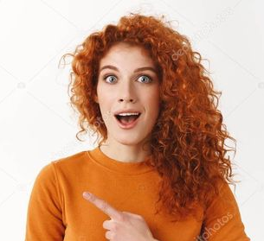
User Persona
Jill Doe
About
Jill is an advertising executive that works for one of the largest advertising agencies in the US. She moved
to San Francisco to take the job and lives in an apartment with two of her sorority sisters. She went to school
for graphic design and hopes to get into selling art some day so moved to San Francisco, but hasn’t found
much time to work on her art. She thinks she might apply for her manager’s job when she goes to work for a
customer next month but isn’t sure yet.
“I am obsessed with
getting my customers
the best ad buys”
Age
29
Goals
Needs
Title
Advertising Buyer
Spend more time
Take the
Do a bit of
Spend more time
Take the
Do a bit of
Location
San Francisco
Education
BA, University of Texas
Stylish
Analytical
Pain Points
Personality
Compassionate
Energetic
Constantly re-learning tools like Google Analytics as they change the features
Spend hours every day manually pasting information between tools
Cannot bring in others to help/collaborate on live documents
Introvert
Extrovert
Favorite Tools
Analytical
Creative
Busy
Open Schedule
Chaotic
Organized
Independent
Team Oriented

